Slide 1
Terraform attributes
OW

Slide 2
Topics
Terraform attributes
Types of Terraform Attribute
Input Attributes
Output Attributes
Computed Attributes
Accessing Terraform Attributes
Impact of Attributes on Resource Configuration
Best Practices for Working with Attributes

Slide 3
Terraform attributes
Terraform, attributes are properties or characteristics of resources managed by Terraform. They provide information about the current state or configuration of a resource.
Attributes are specific to each resource type and describe the characteristics of that particular resource.
Attributes are accessed using the following syntax: resource_type.resource_name.attribute_name. For example, aws_instance.my_instance.id represents the id attribute of the my_instance resource of type aws_instance.

Slide 4
Types of Terraform attributes
Primitive Types: These attribute types represent basic data types such as strings, numbers, booleans, and lists. Examples include string, number, bool, and list.
Complex Types: These attribute types represent complex data structures that can hold multiple values or nested attributes. Examples include map, object, and tuple.
Resource References: These attribute types refer to other resources in the Terraform configuration. They establish relationships and dependencies between resources. Examples include resource and data types.
Computed Attributes: Computed attributes are derived from the state of a resource and are automatically updated by Terraform. They cannot be directly set or modified in the configuration file but provide information about the resource's current state.

Slide 5
..
Output Attributes: Output attributes are used to expose information from the Terraform configuration. They allow you to share values across modules or provide useful information to users of your Terraform infrastructure.
Meta-Attributes: These attributes provide metadata and additional information about resources. Examples include id, arn, and tags.
Provider-Specific Attributes: Each Terraform provider may define its own set of attributes that are specific to the resources it manages. These attributes offer provider-specific functionality or information related to the underlying infrastructure.

Slide 6
Example of primitive type
ami: This attribute specifies the Amazon Machine Image (AMI) ID to use for the instance. It is of type string and represents the ID of the base image used to launch the instance.
instance_type: This attribute specifies the instance type for the EC2 instance. It is of type string and defines the hardware characteristics of the instance, such as CPU, memory, and network performance.
key_name: This attribute specifies the key pair name used for SSH access to the EC2 instance. It is of type string and represents the name of the key pair stored in AWS.

Slide 7
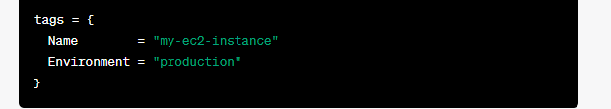
Example of complex type [map type]
map type: map type is a complex attribute type that represents an unordered collection of key-value pairs
In this example, the tags attribute is a map type that allows you to assign key-value pairs to the EC2 instance's tags.
You can access the values of a map using the key. For example, to access the value of the "Name" key in the tags map, you would use tags["Name"].

Slide 8
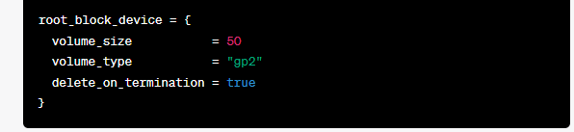
Object Type
Object type is a complex attribute type that represents a structured collection of named attributes. It allows you to define and configure a set of related attributes as a single object.
Here, the root_block_device attribute is an object type that defines the properties of the root block device of the EC2 instance, such as the volume size, volume type, and whether it should be deleted on instance termination.
You can access the values of an object attribute using the dot notation (.) to specify the attribute within the object. For example, to access the volume_size attribute within the root_block_device object, you would use root_block_device.volume_size.

Slide 9
Tuple type
Tuple type is a complex attribute type that represents an ordered sequence of values. It allows you to define and configure a collection of related attributes that maintain their order.
Tuple attribute is defined using square brackets [] and contains a comma-separated list of values. For example:
You can access individual values within a tuple using zero-based indexing. For example, security_groups[0] would refer to the first value in the security_groups tuple, and security_groups[1] would refer to the second value.

Slide 10
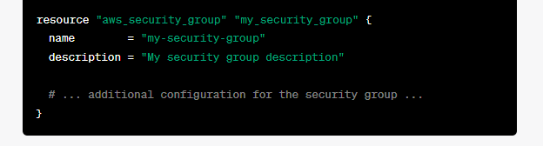
Resource Reference Attributes
Resource reference attributes to establish relationships and dependencies between resources.
Examples: You have an EC2 instance and a security group resource defined in your Terraform configuration. You want to associate the security group with the EC2 instance. Here's how you can achieve that:

Slide 11
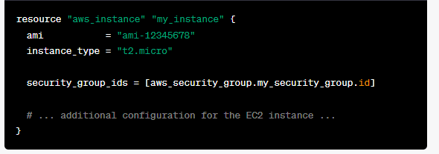
..
Define the EC2 Instance resource and reference the Security Group:
In this example, the security_group_ids attribute of the EC2 instance resource references the id attribute of the aws_security_group.my_security_group resource. This establishes a relationship between the EC2 instance and the security group.

Slide 12
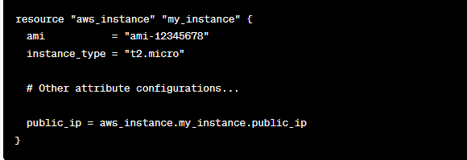
Computed Attributes
Computed attribute is an attribute of a resource whose value is determined by Terraform itself based on the state of the resource or other factors.
It allows you to derive values dynamically within your configuration.
In this example, we have an EC2 instance resource named my_instance. We want to assign the public IP address of the instance to a variable called public_ip.

Slide 13
..
However, the public IP address is not known until the instance is created and assigned an IP address by AWS. Therefore, we use a computed attribute public_ip to retrieve the dynamically assigned public IP address.
By referencing aws_instance.my_instance.public_ip, Terraform will automatically determine the actual public IP address of the instance once it is provisioned. Terraform will then use that value for further configurations or outputs.
Computed attributes are useful when you need to capture or use values that are determined by the provider at runtime. Examples of computed attributes in EC2 instances include public IP addresses, private IP addresses, DNS names, and more.

Slide 14
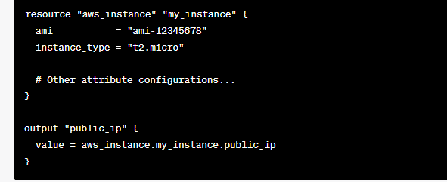
Output Attributes
Output attributes allow you to define values that are exposed after applying your configuration. Outputs are useful for displaying information or making it accessible for other systems or users
In this example, we have an EC2 instance resource named my_instance. We want to define an output attribute called public_ip that displays the public IP address of the EC2 instance.

Slide 15
..
The output block specifies the name of the output attribute, which in this case is public_ip. The value of the output attribute is set to aws_instance.my_instance.public_ip, which refers to the public IP address attribute of the EC2 instance resource.
To retrieve the value of the output attribute, you can use the terraform output command after applying the configuration. For example, running terraform output public_ip will display the public IP address of the EC2 instance.

Slide 16
Meta Attributes
Meta-attributes are special attributes that provide additional functionality and control over resource behavior
depends_on : The depends_on meta-attribute allows you to specify explicit dependencies between resources.
count: The count meta-attribute allows you to create multiple instances of a resource based on a count expression
lifecycle: The lifecycle meta-attribute allows you to manage the lifecycle of a resource, including whether or not it should be replaced or updated.

Slide 17
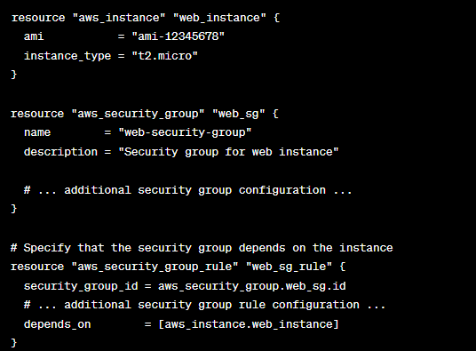
Depends_on
In this example
The aws_security_group_rule resource depends on the aws_instance resource. Terraform ensures that the instance is created before creating the security group rule

Slide 18
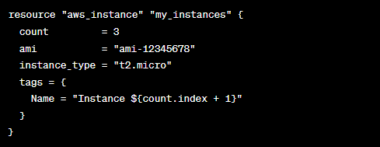
Count
In this example, three EC2 instances will be created with names "Instance 1", "Instance 2", and "Instance 3". The count.index variable allows you to access the current index within the count expression.

Slide 19
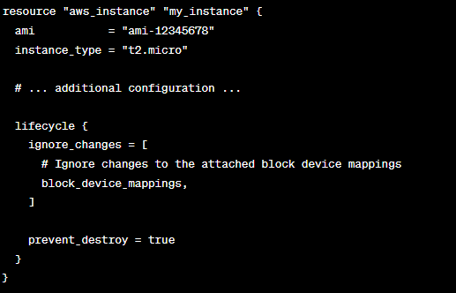
lifecycle
In this example, the ignore_changes attribute within the lifecycle block tells Terraform to ignore changes to the block_device_mappings attribute when determining if the resource needs to be replaced or updated. The prevent_destroy attribute ensures that the instance cannot be destroyed by Terraform.

Slide 20
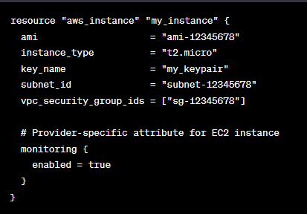
Provider-specific attribute
Provider-specific attributes are specific to a particular provider and allow you to configure resources with provider-specific settings or options. These attributes provide fine-grained control over the behavior of resources in the context of the chosen provide

Slide 21
..
In this example, we have an EC2 instance resource named my_instance with various attributes, such as ami, instance_type, key_name, subnet_id, and vpc_security_group_ids. These attributes are specific to the EC2 resource type and are generally applicable across different providers.
However, there are also provider-specific attributes that allow you to configure provider-specific settings for the resource. In this case, we have the monitoring block as a provider-specific attribute for the EC2 instance resource. Within the monitoring block, we set the enabled attribute to true, enabling detailed monitoring for the EC2 instance.

Slide 22
Best Practices for Working with Attributes
Read and understand resource documentation
Follow the principle of least privilege
Validate attribute values
Review and validate changes
Leverage output attributes

